Slide 1

ProMail /
Direct Mail powered by ProMax
Are you working with the winner of Auto Dealer Monthly’s Diamond Award for Direct Mail 3 years in a row to drive more traffic to your dealership?

Slide 2

What Direct Mail pieces do we offer?
Event Mailers

Slide 3


What Direct Mail pieces do we offer?
Black Book & Buy Back Mailers

Slide 4



What Direct Mail pieces do we offer?
Service Mailers

Slide 5
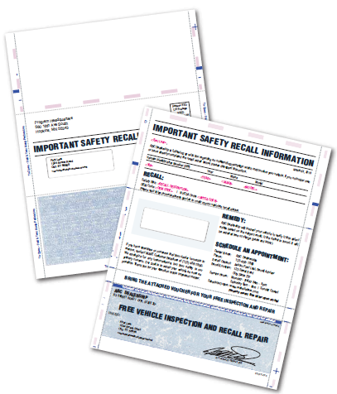
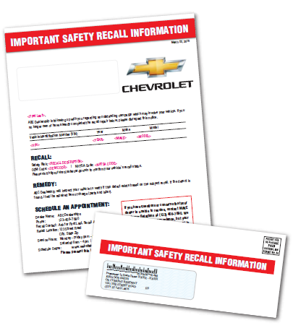
What Direct Mail pieces do we offer?
Recall Mailers

Slide 6


What Direct Mail pieces do we offer?
Postcards

Slide 7
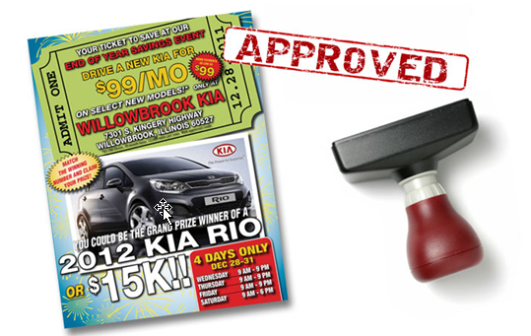
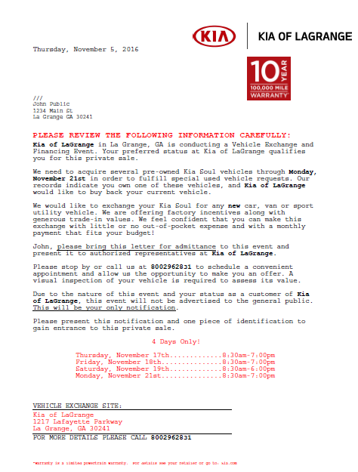
What Direct Mail pieces do we offer?
Co-op Approved Mailers

Slide 8
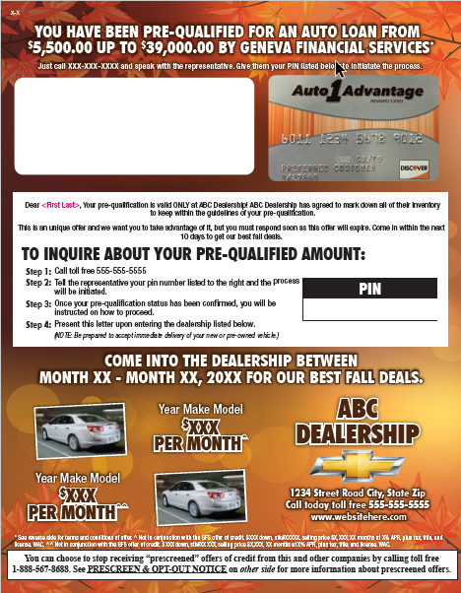

What Direct Mail pieces do we offer?
Credit Card Mailers

Slide 9

What Direct Mail pieces do we offer?
Trade Equity Mailers

Slide 10

What Direct Mail pieces do we offer?
Holiday Mailers

Slide 11
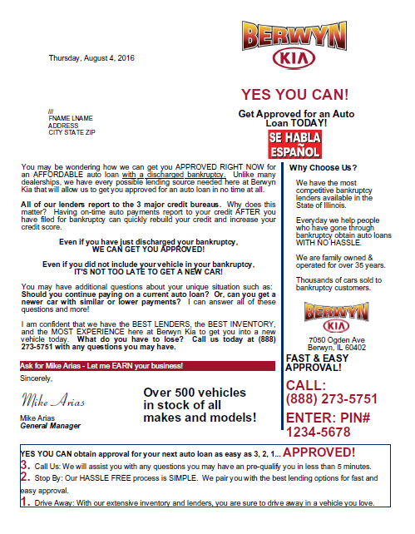
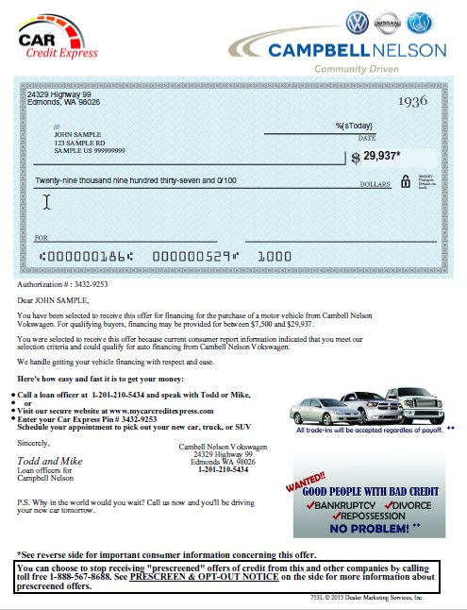
What Direct Mail pieces do we offer?
BK & SubPrime Mailers

Slide 12
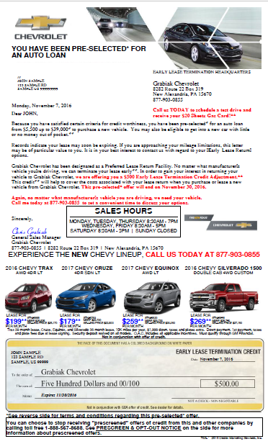
What Direct Mail pieces do we offer?
Lease Termination Mailers

Slide 13
Key benefits of using
Direct Mail with ProMax
Customized wide range of unique mail pieces and envelopes
When targeting Credit Score, mail is available for everything from No Score to 800+
Fully integrated with ProMax
  BDC Services available to call leads and set appointments
Professional staff with automotive experience and expertise
In-house fulfillment center – data never leaves our facility we handle everything
Full Data Analysis for every market to ensure dealers get the exact list they want for their dealership
High open rates with hundreds of options, many co-op approved

Slide 14
How will it increase your showroom traffic, sales, and profit?
Wisely target your advertising budget towards a direct mail program that will drive traffic and sales into your showroom by sending your message to the right consumers at the right time.
Our Direct Mail program, powered by ProMax Unlimited, has many filter options that allow you to remove consumers that can’t buy or aren’t in the market to buy leaving you with a targeted list of consumers ready and able to purchase a vehicle.

Slide 15
Data Analysis filter options
(narrow in on the customer you want to target)
Zip Code Radius
Credit Bureau Score Range
Bankruptcy Status
No Repossessions
Remaining balance
Interest Rate on Current Loan
Last Purchase Date
Type of Vehicle
% of Auto Loan Paid
# of Open Loans
Months remaining on Lease
Open Auto Loan Payment Amount
Open Auto Loan Payoff Amount
2 or 3 years minimum credit indicator
Revolving Account Balance
Age
Estimated Income
Homeowner / Renter
Length of Residence

Slide 16
“My business has quadrupled”
I have used other companies in the past for mail, but never received the correct data or results that they have been able to give me. Since ProMax has taken over my mail campaigns, I’m getting the results I need to make my business grow to no end. They’ve worked very hard for me and I’ll continue to do more and more mail campaigns with them throughout the years to come. I have quadrupled my business since working with ProMax Marketing.
Thomas Domin
President / CEO
Concierge Auto Brokers

Slide 17
Summary & Recap
We deliver results! Supercharge your lead generation efforts with ProMax’s award-winning Direct Mail solutions
Data is our specialty – full analysis, in house fulfillment, and unmatched compliance credentials
High open rates with hundreds of options, many co-op approved
Fully integrated with ProMax
Optional BDC Services to call leads and set appointments

Slide 18
ProMail / Direct Mail
Dealer Marketing Services, Inc
Makers of ProMax Unlimited &
ProCredit Express
563-344-7610

